Slide 1
COVID-19 Convalescent Plasma

Slide 2
Agenda
Investigational Product( Convalescent Plasma) - Updates
COVID-19 Convalescent Plasma Trials.
Locator Database - new fields
Instructions on the Locator Data Entry
Reminders - Plasma Units Inventory
CSSC – Central Pharmacist Manager
Anusha Yarava, PharmD, MPH
August 02, 2021
Training Documentation
Questions / other items

Slide 3
#1: CP Restricted in Line the EUA Qualification Requirements
EUROIMMUN ratio ≥ 3.5 OD
FDA approval on April 19th 2021
Central IRB approval (July 21, 2021)
PLEASE COMPLETE ANY PENDING LOCAL IRB NOTIFICATIONS

Slide 4
Central IP team - Instructions (Inventory Management)
Central Blood Bank team have sent instructions to each individual blood bank regarding high titer plasma units qualification.
To isolate the non-Euroimmun qualified products from the sites inventory.
SN will work to return the nonqualified product to the JHU lab in this week.

Slide 5
Non – Euroimmun Qualified Units
The list has unknown Euroimmun ratio values.
We are working on pending Euroimmun Ab results.
A list will be shared, when available.

Slide 6
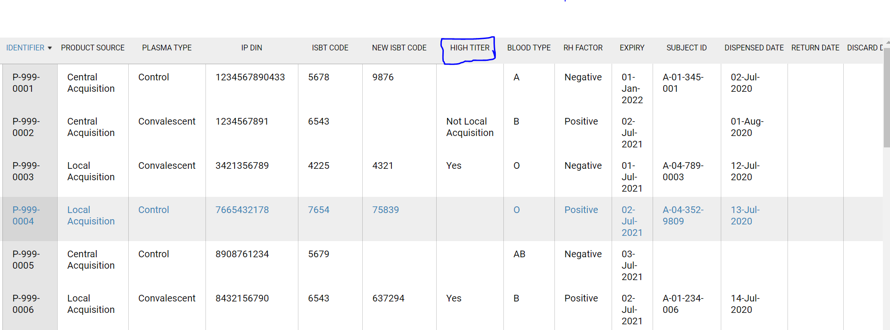
Locator Changes – Plasma Display Page.

Slide 7
Locator Data Entry
IP return reason: Return of Non-Euroimmun Qualified Product to JHU lab as per (JHU- Central Pharmacist Request).
The assigned monitor will review the data entry & follow up with your sites for any data entry corrections.

Slide 8
Shipping Address
Shipping address to return the non-Euroimmun qualified product.
Shipping address:
Attention to: Dr. David Sullivan
615 N. Wolfe Street Room W4612
Baltimore, Maryland 21205
Email ID: dsulliv7@jhmi.edu
Point of Contact :
Manju Thakar (JHU lab Specialist)
Cell# 410 599 5496
Email: mthakar3@jhu.edu

Slide 9
#2: FDA Approval on Extension of Product Expiration Dates
FDA approval on July 12, 2021
Extending the product expiration date by 3 months
For convalescent plasma product only under use of IND 19725
CCP products with expiration dates in May, June, July, and August 2021, are extended by 3 months.

Slide 10
Central IP team - Instructions on Extension of Product Expiration Dates
Last Monday - Blood banks received individual emails with the list of DIN’s and the new expiration dates.
We request the Blood Banks to immediately
Update your internal records with the new expiration dates.
Relabel the product with the new expiration dates.
Comply with the FDA approval on July 12th 2021.

Slide 11
Locator changes – Plasma Info page

Slide 12
Locator changes – Plasma Info page

Slide 13
Locator changes – Plasma Info page

Slide 14
Locator changes – Plasma Info page

Slide 15
Display Page

Slide 16
Locator Data Entry - New Expiration Dates
(Sonya Griffin & Melanie Morabito) – assigned monitors to your sites – will unfinalize the plasma Info page.
Only, then you will have access to enter the new expiration date.
Weekly emails will be sent to each BB with the list of Euroimmun qualified DIN’s & new expiration dates.

Slide 17
Plasma Inventory - Reminders
August 1st 2021, only CCP units qualified for Euroimmun ratio ≥ 3.5 OD will be used for any patient enrollments under IND 19725.
Short supplied with AB units, we request the blood banks to use AB units for only AB patients.
Don’t discard any IP product or thaw the near expiration product.
Please update the (May, June, July, & August expiry dates) from 12 months to 15 months.
Study plasma units must be only used for the study enrollments.

Slide 18
Training Documentation
Protocol version 9
IP transfer training log
IP manual version 12
Manual for the Locator Data Entry – Version 1
Sonya Griffin & Melanie Morabito – Point of Contact from Central team.

Slide 19
Next Upcoming Training
Locator – Data Entry common mistakes.
Next week, monitors will coordinate about the training session.

